Slide 1
Training BERTimbau
Sentiment Classification Model

Slide 2

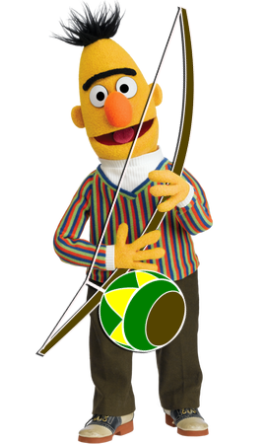
BERTimbau
BERT-BASE-PORTUGUESE-CASED
- pre trained in brazilian portuguese
- sentence textual similarity
- recognizing textual entailment
- name entity recognition

Slide 3
– 9:1 TRAIN/TEST SPLIT –

Slide 4
PREPARING THE DATA…

Slide 5
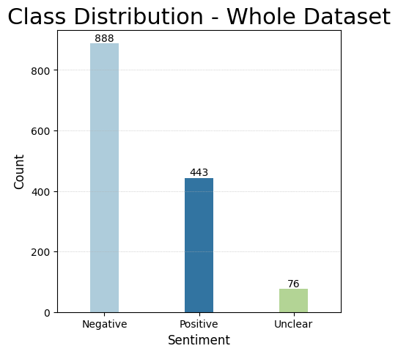

Slide 6
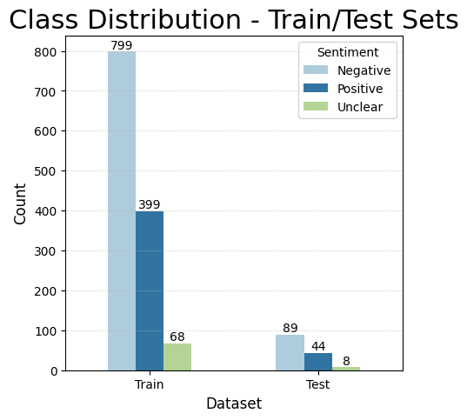

Slide 7
TEST BERTimbau…

Slide 8
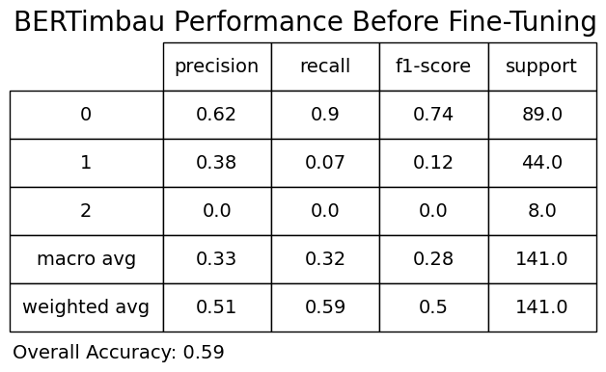

Slide 9
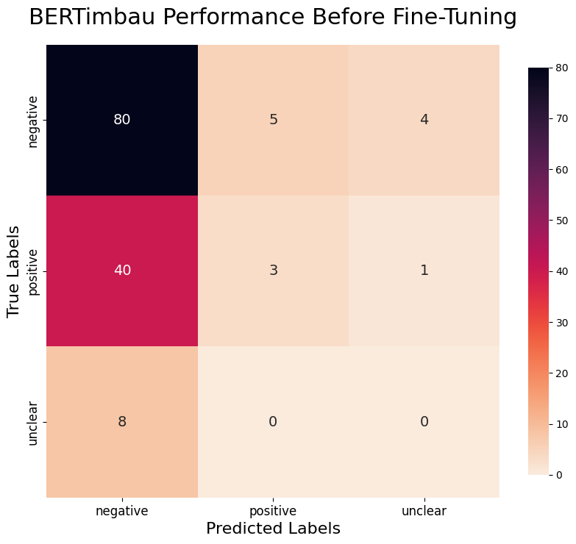

Slide 10
FINE TUNING…

Slide 11
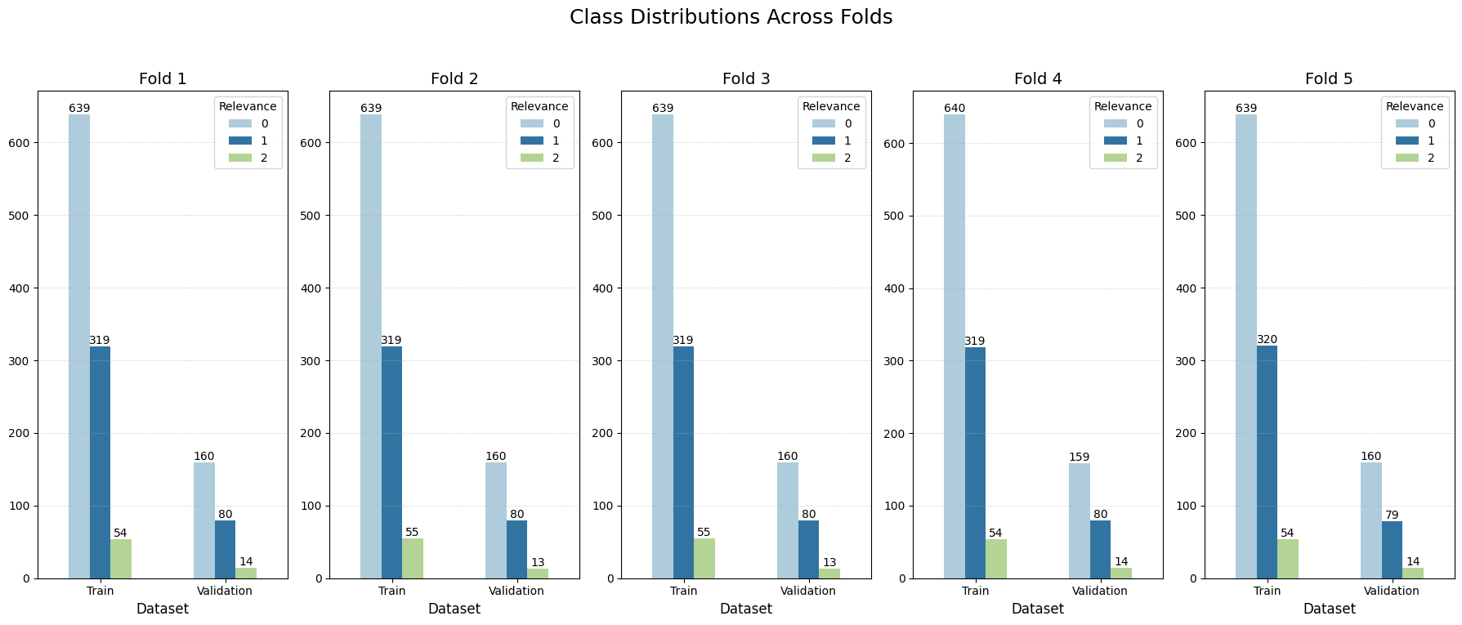

Slide 12
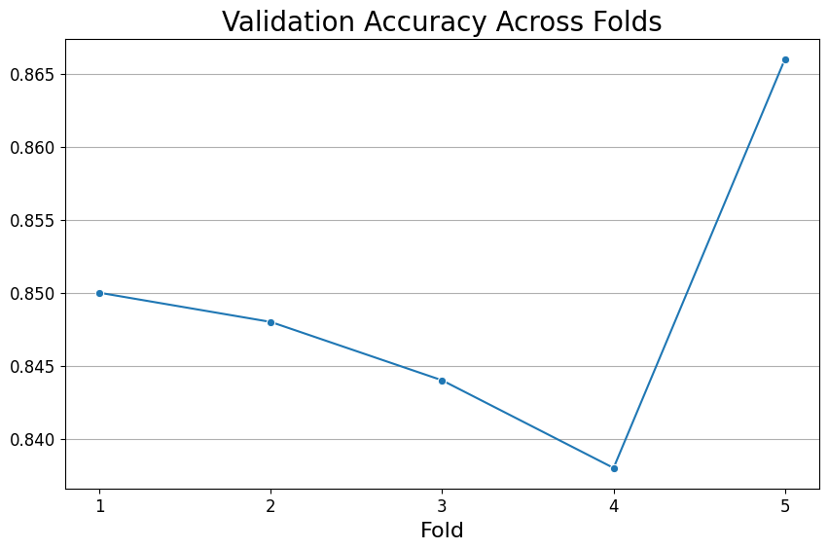

Slide 13
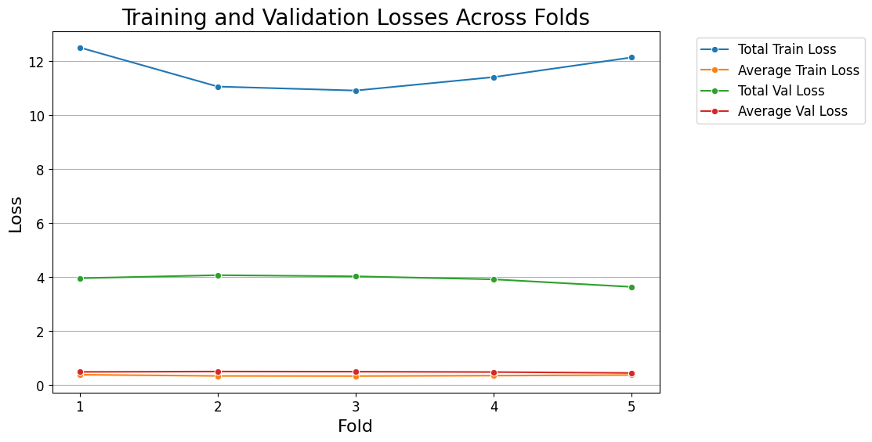

Slide 14
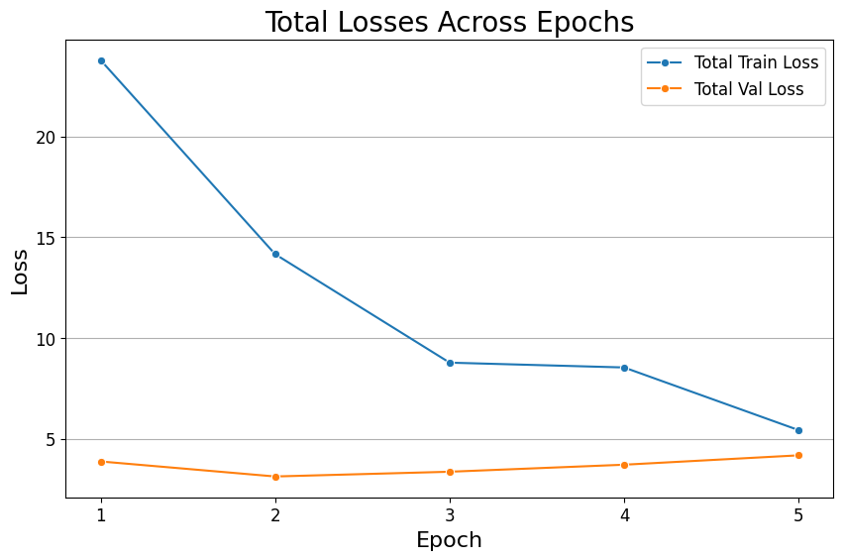

Slide 15
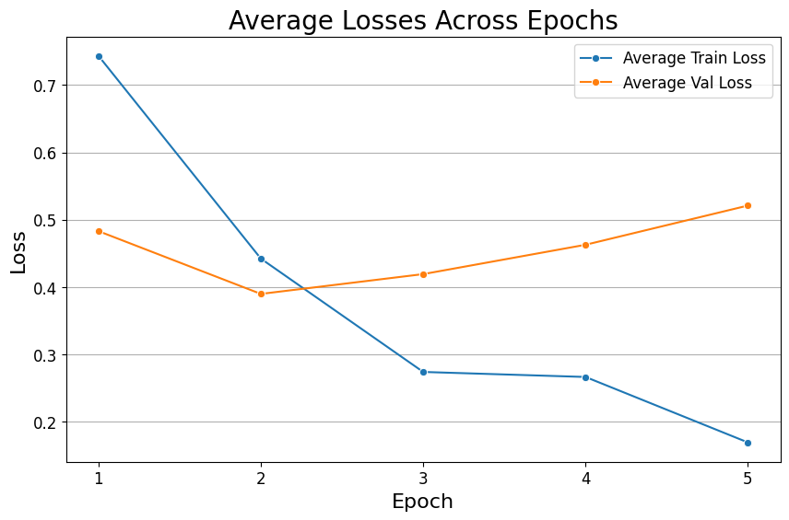

Slide 16
TEST NEW MODEL…

Slide 17
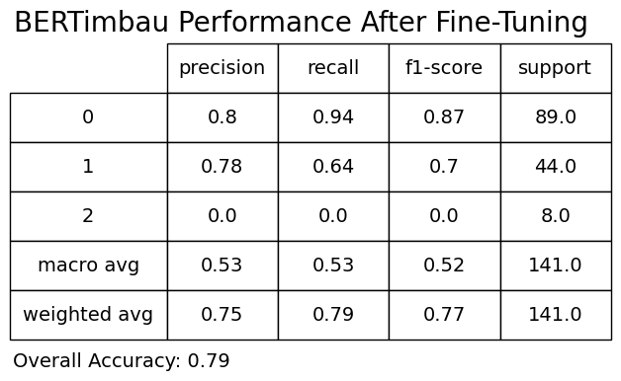

Slide 19
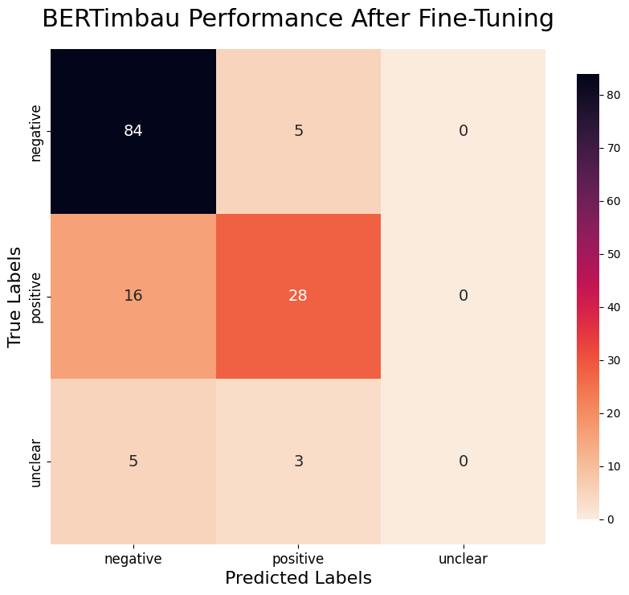

Slide 21
– 7:3 TRAIN/TEST SPLIT –

Slide 22
PREPARING THE DATA…

Slide 23
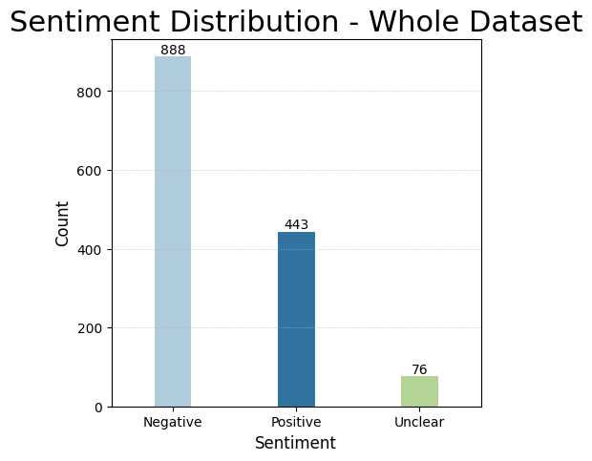

Slide 24
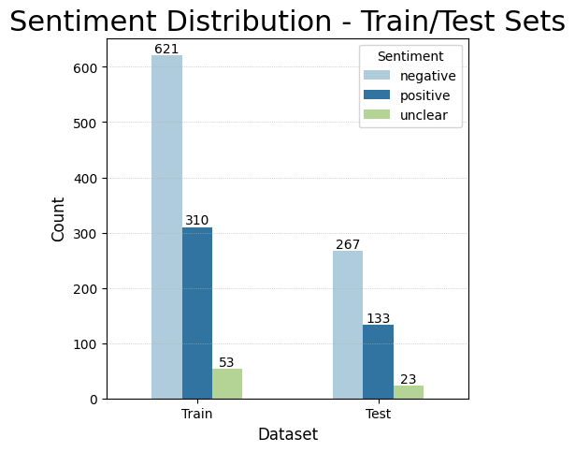

Slide 25
TEST BERTimbau…

Slide 26
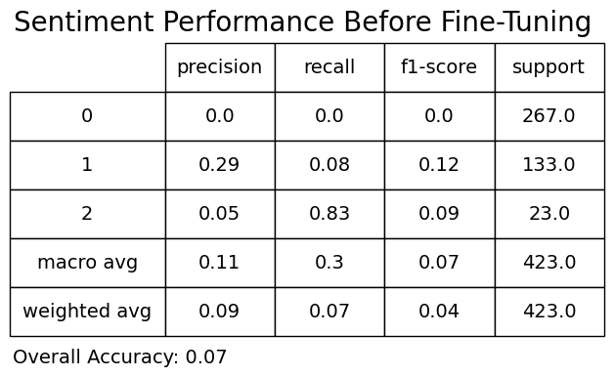

Slide 27
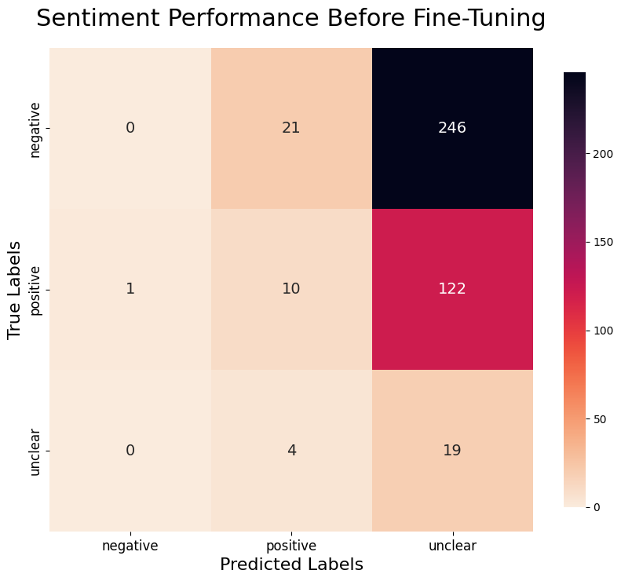

Slide 28
FINE TUNING…

Slide 29
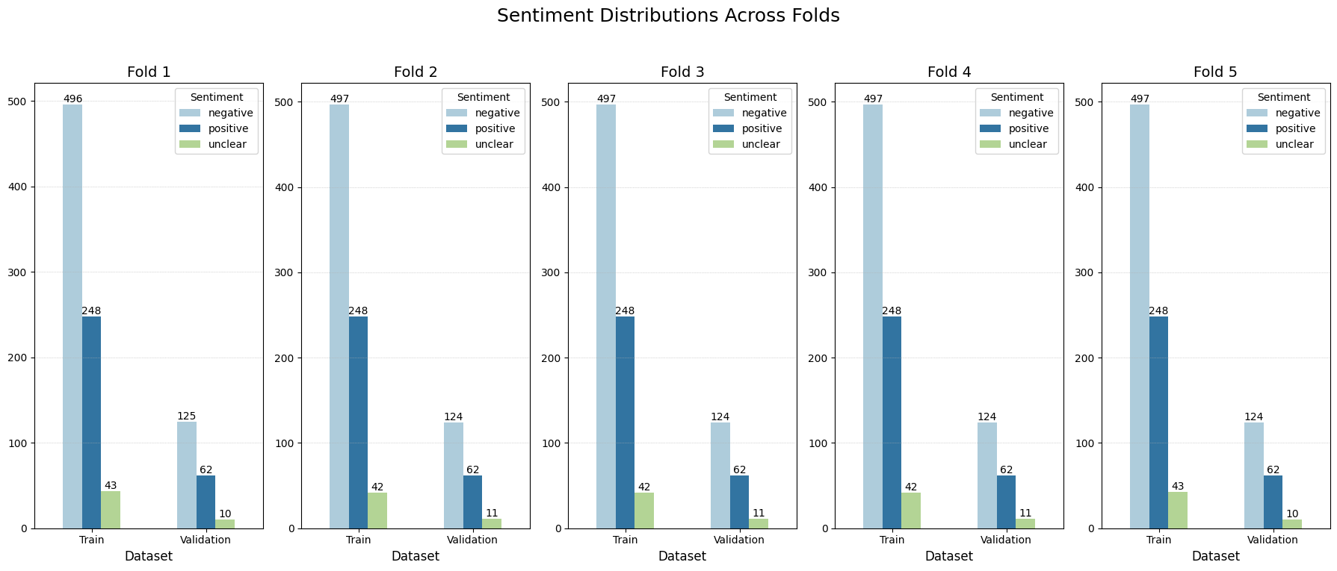

Slide 30
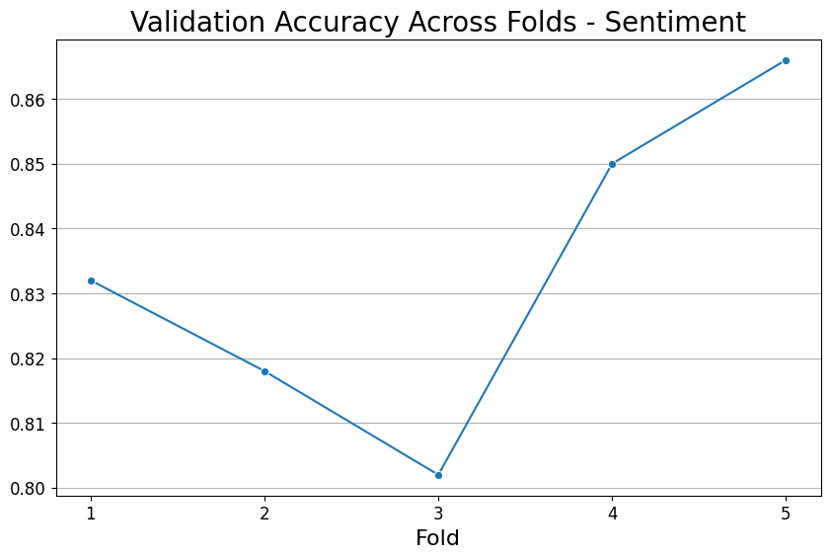

Slide 31
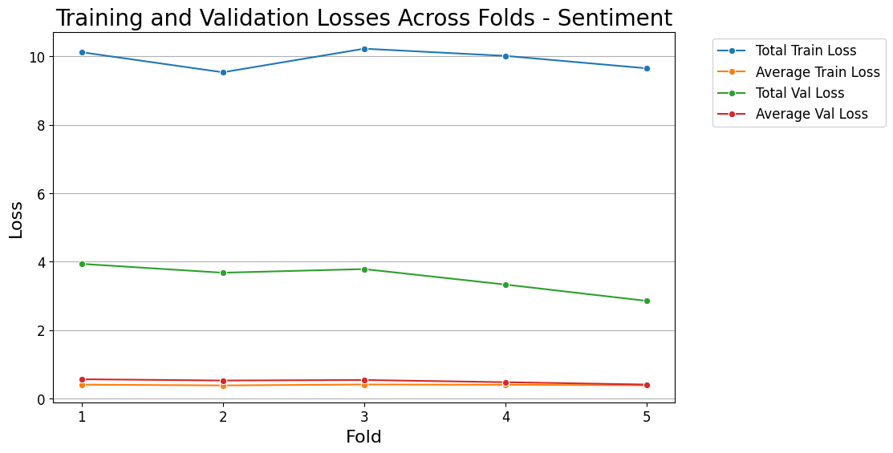

Slide 32
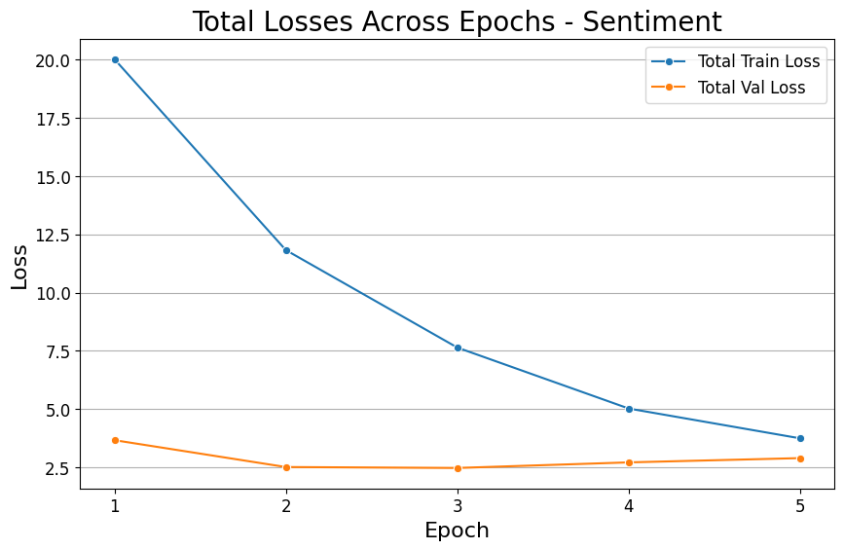

Slide 33
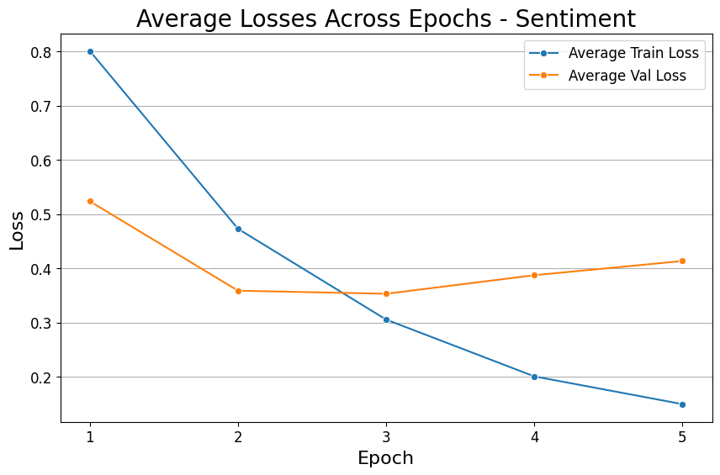

Slide 34
TEST NEW MODEL…

Slide 35
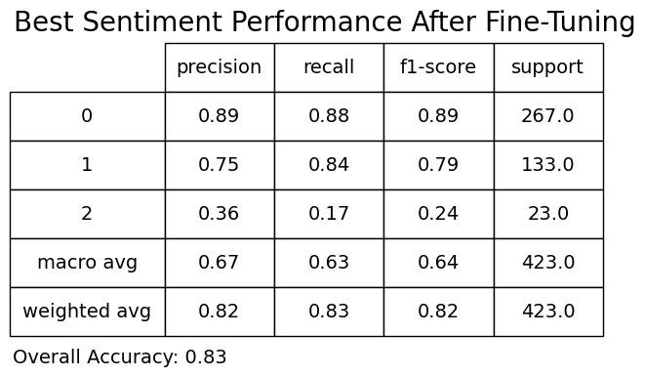

Slide 37
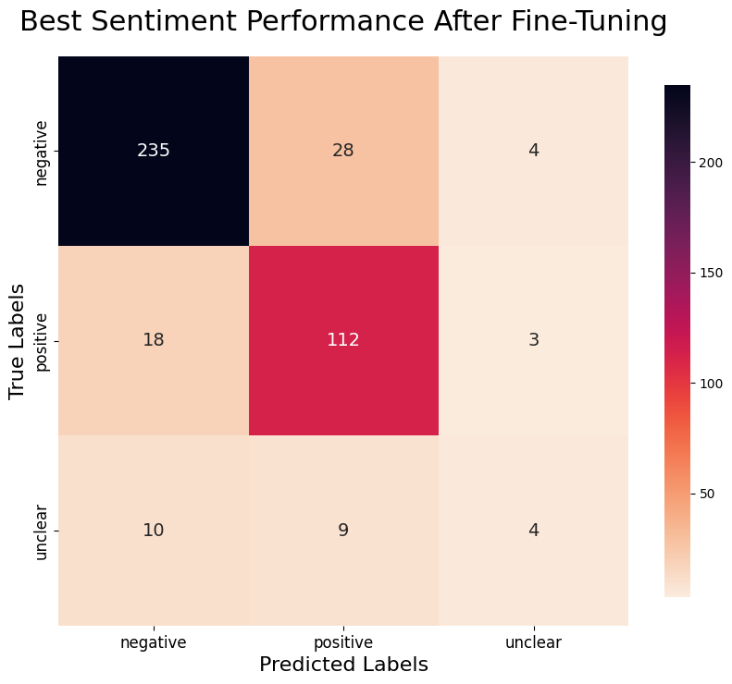

Slide 39
EVALUATION ACROSS FOLDS…

Slide 40
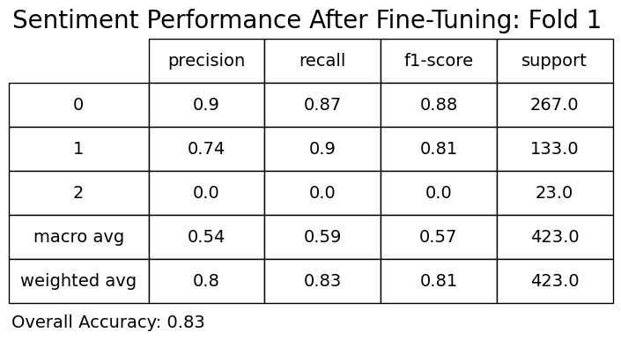

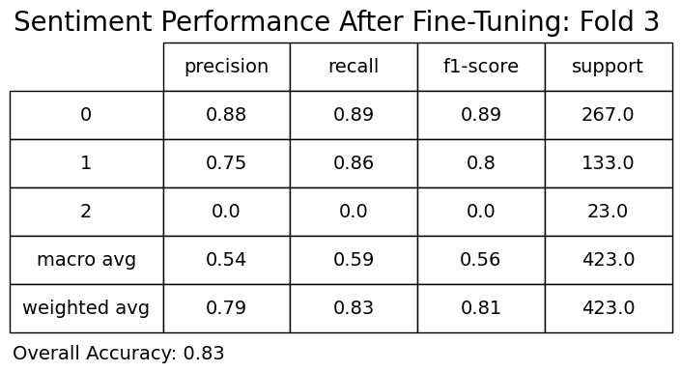

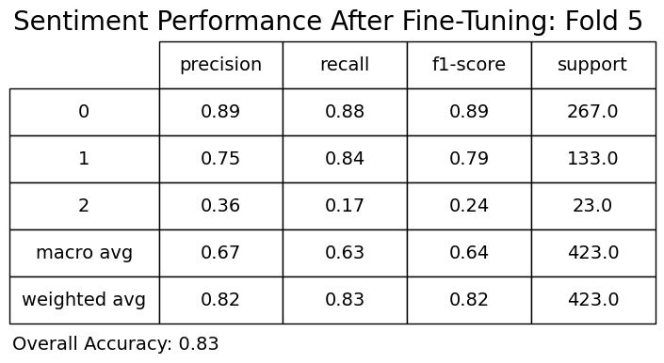

Slide 41
